Slide 1
NATURAL GAS PRICE PREDICTION
Project by Team CSEC005:
Nikhat Parveen
Syeda Aayesha Kaleem
Zeenat Sehar

Slide 2
INTRODUCTION
Natural Gas has been proposed as a solution to increase the security of energy supply and reduce environmental pollution around the world.
Being able to forecast natural gas price benefits various stakeholders and has become a very valuable tool for all market participants in competitive natural gas markets.

Slide 3
ABOUT OUR PROJECT
Prediction of Natural Gas Price, commercially is important to know. The purpose of this model is to predict the spot price of Natural Gas when the date is taken as the input given by the user. It then predicts the price of the Gas on that specific day.
In this model, we are using the Machine learning algorithms to help predict the values. We chose Decision Tree Regression Algorithm in this model.

Slide 4
THEORETICAL ANALYSIS
Machines learning is a study of using algorithms and statistics to make the computer to learn by itself without being programmed explicitly by the user.
There are multiple learning algorithms that can be used to solve the problem but the concept remains the same. All these algorithms fall into two categories:
(i) Supervised learning
(ii) Unsupervised learning.

Slide 5
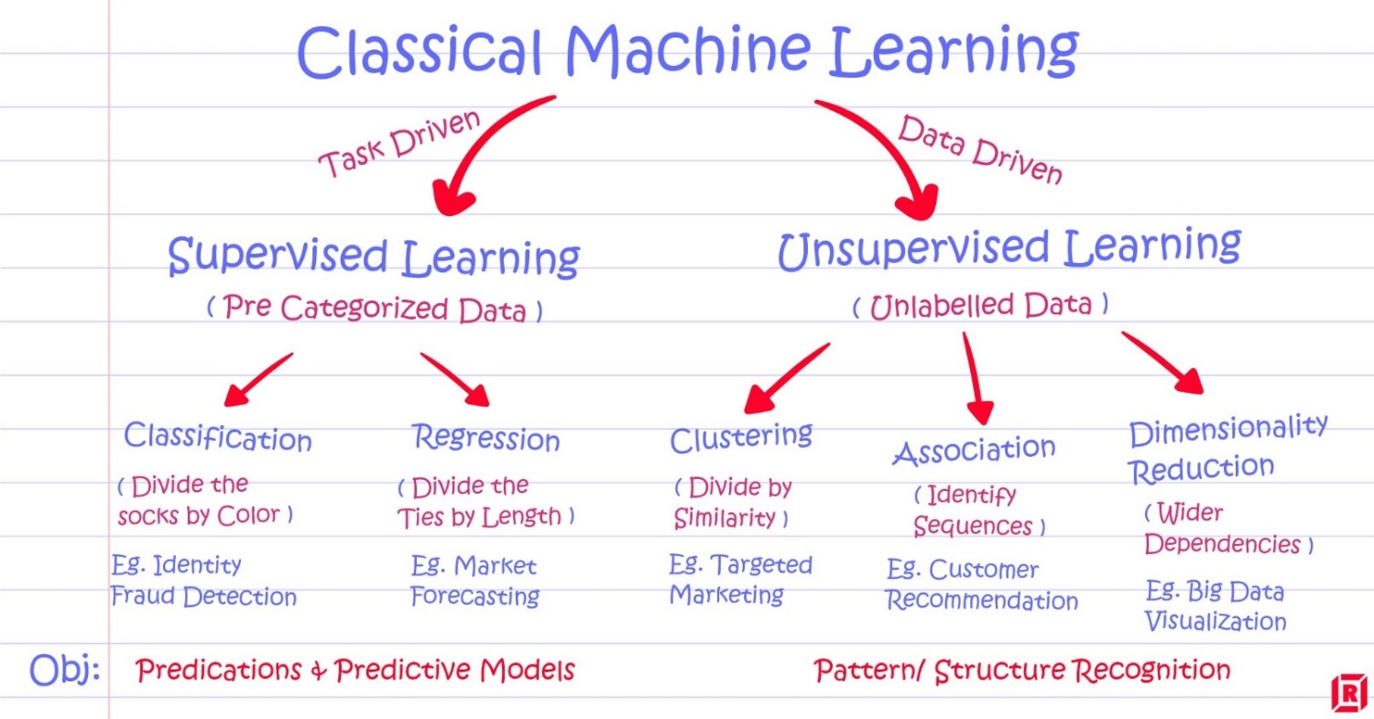
WHAT IS SUPERVISED LEARNING?
WHAT IS REGRESSION?
WHAT ARE THE DIFFERENT TYPES OF REGRESSION ALGORITHMS?
WHICH ALGORITHM SHOULD OUR MODEL BE TRAINED ON?
WHY WOULD YOU CHOOSE THIS ALGORITHM?

Slide 6
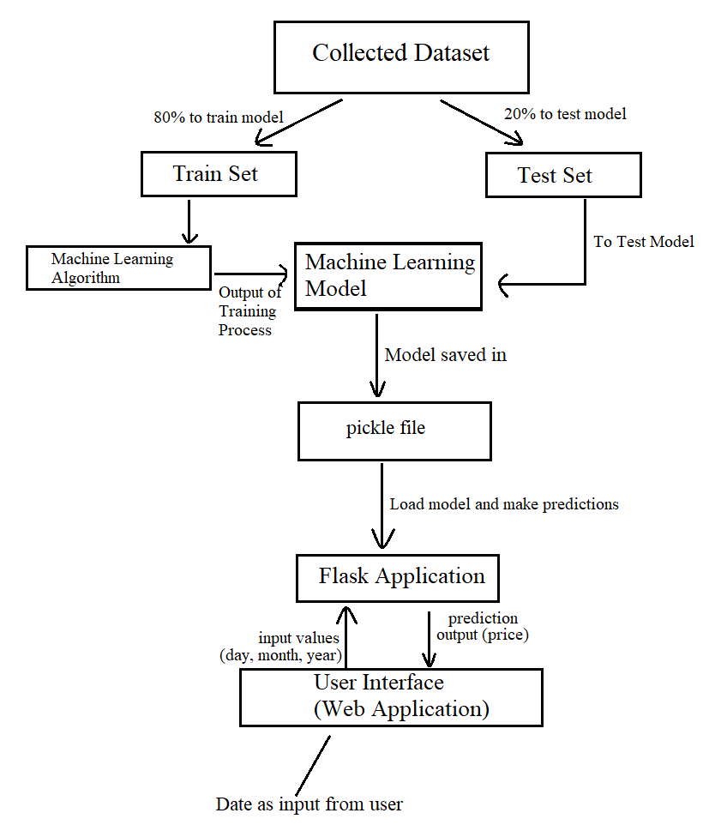

Slide 7
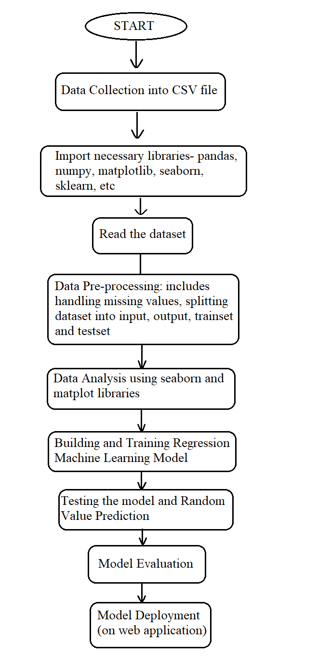
EXPERIMENTAL INVESTIGATION
Flowchart:
This flowchart indicates the process followed for building and implementing the model.

Slide 8
Accuracy Calculated For Each Algorithm For Model Building.
Sno. | Algorithms | Accuracy | Selected Yes/No | Reasons
1. | Multilinear Regression | 0.06567 | No | Very low accuracy
2. | Decision Tree Regression | 0.9754 | Yes | Accuracy can be used as it is not too low or high
3. | Random Forest Regression | 0.9895 | No | Machine over trained

Slide 9
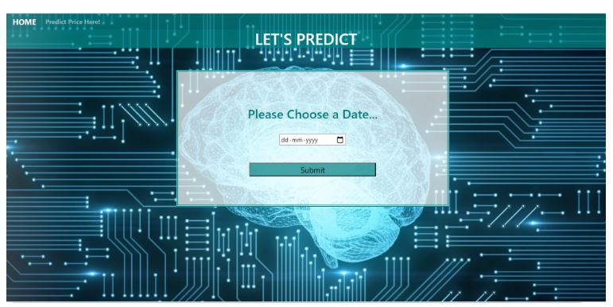
USER INTERFACE (WEB APPLICATION)
The interface (UI) is that the point of human-computer interaction and communication during a device.
It is the way through which the user interacts with an application or a website.
The application is created using Flask app.
The UI is developed using html5, CSS3, and bootstrap.

Slide 10
RESULT
The Result predicted is shown in the image. We used Decision Tree Regression because it has an accuracy of 97.55%.
The model is then integrated to our UI, which predicts the price of Natural Gas.

Slide 11
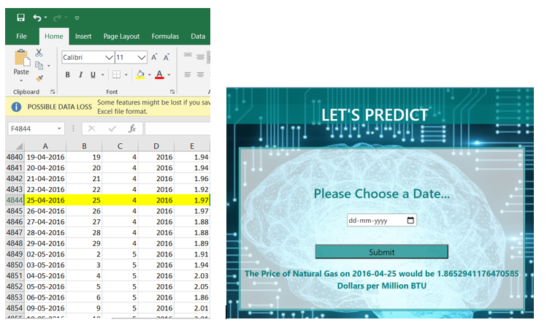
Comparison of price on date 25-04-2016 in the dataset and the UI

Slide 12
Let’s watch the live demo of our working project, to see the predicted values for the date given as the input.
http://localhost:5000/

Slide 13
Thank You
Conclusion:
The beautifully designed UI is an attractive and a user friendly page, that satisfies the user by giving the required information.

